Slide 1
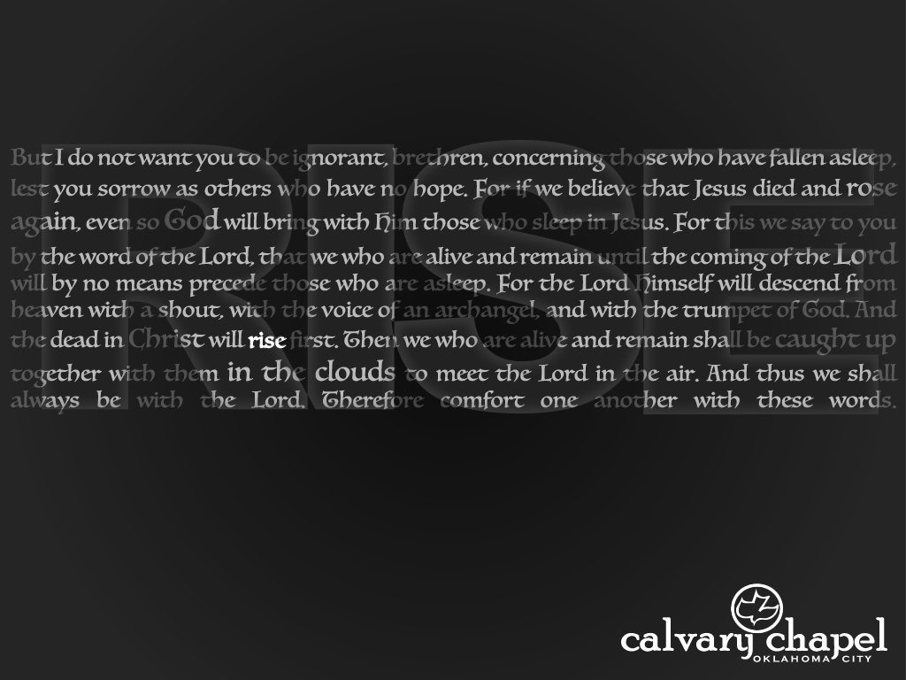


1 Thessalonians 5:3-28
a cd of this message will be available (free of charge) immediately following today’s service
a podcast will be available later in the week at calvaryokc.com
This Photo by Unknown Author is licensed under CC BY-SA

Slide 2
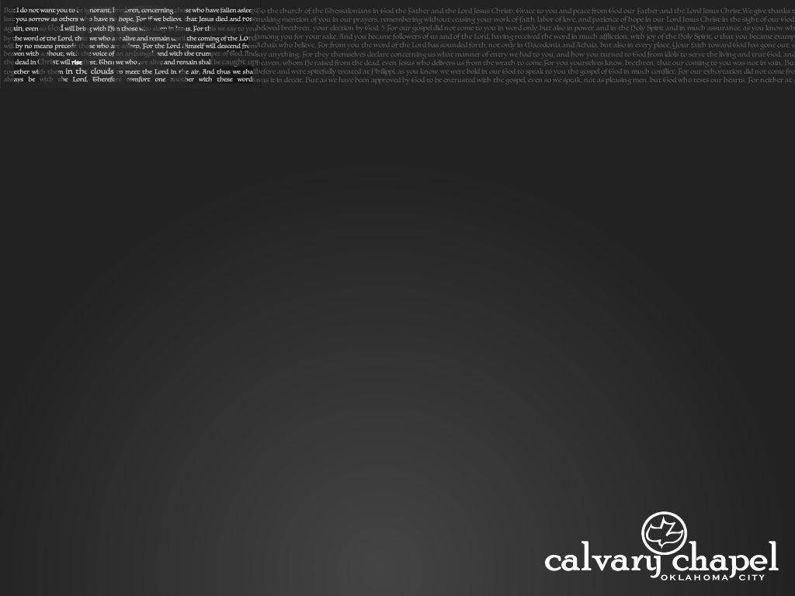
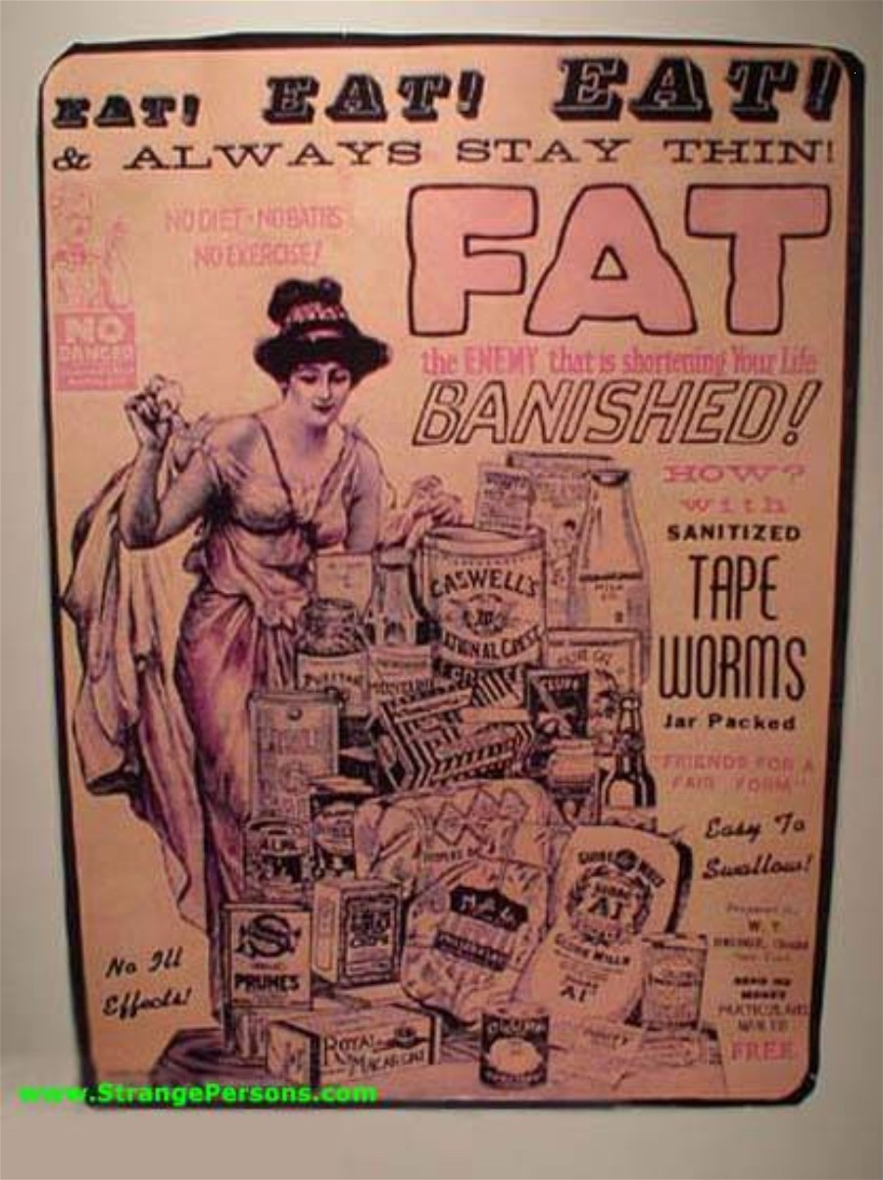
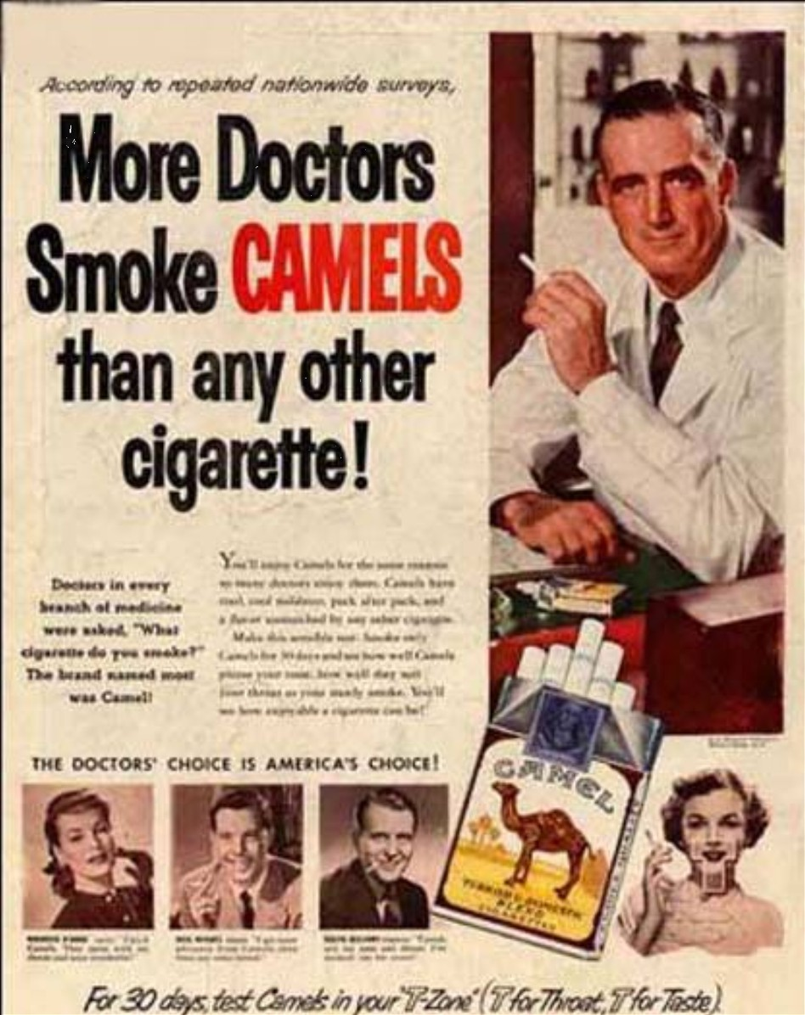
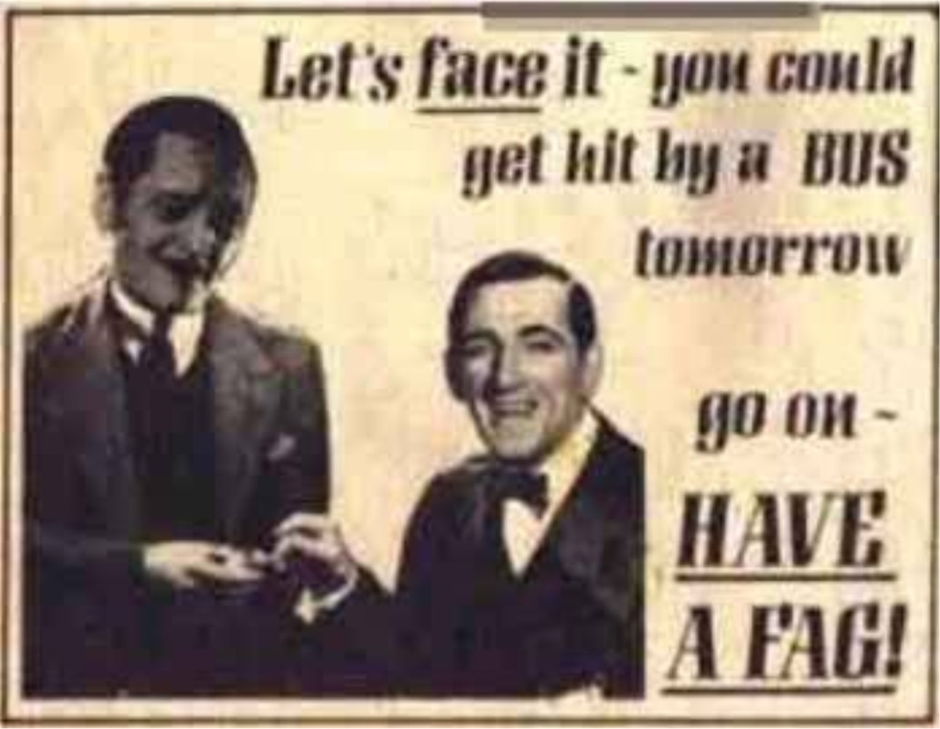
1 Thessalonians 5:3-28

Slide 3
1 Thessalonians 5:3-28

Slide 4
Over 1/4 of the Bible was prophetic at the time it was written (Encyclopedia of Biblical Prophecies – J. Barton Payne)
Two lessons from looking at fulfilled prophecy:
1. The Bible has a 100% track record
2. Always fulfilled literally
1 Thessalonians 5:3-28

Slide 5
1 Thessalonians 5:3-28

Slide 6
2 Reasons for the Tribulation:
1. Reveal Jesus as the Messiah to the Jews
Rom. 11:25-26a ~ ²⁵ For I do not desire, brethren, that you should be ignorant of this mystery, lest you should be wise in your own opinion, that blindness in part has happened to Israel until the fullness of the Gentiles has come in. ^{26a} And so all Israel will be saved …
1 Thessalonians 5:3-28

Slide 7
2 Reasons for the Tribulation:
1. Reveal Jesus as the Messiah to the Jews
Zech. 12:10 ~ And I will pour on the house of David and on the inhabitants of Jerusalem the Spirit of grace and supplication; then they will look on Me whom they pierced. Yes, they will mourn for Him as one mourns for his only son, and grieve for Him as one grieves for a firstborn.
1 Thessalonians 5:3-28

Slide 8
2 Reasons for the Tribulation:
1. Reveal Jesus as the Messiah to the Jews
Matt. 21:9b ~ “Hosanna to the Son of David!
‘Blessed is He who comes in the name of the Lord!’
Hosanna in the highest!”
1 Thessalonians 5:3-28

Slide 9
2 Reasons for the Tribulation:
1. Reveal Jesus as the Messiah to the Jews
Matt. 23:37–39 ~ ³⁷ “O Jerusalem, Jerusalem, the one who kills the prophets and stones those who are sent to her! How often I wanted to gather your children together, as a hen gathers her chicks under her wings, but you were not willing! ³⁸ See! Your house is left to you desolate; ³⁹ for I say to you, you shall see Me no more till you say, ‘Blessed is He who comes in the name of the Lord!’”
1 Thessalonians 5:3-28

Slide 10
2 Reasons for the Tribulation:
2. Judge the world for rejecting Him
Rev. 6:15-17 ~ ¹⁵ And the kings of the earth, the great men, the rich men, the commanders, the mighty men, every slave and every free man, hid themselves in the caves and in the rocks of the mountains, ¹⁶ and said to the mountains and rocks, “Fall on us and hide us from the face of Him who sits on the throne and from the wrath of the Lamb! ¹⁷ For the great day of His wrath has come, and who is able to stand?”
1 Thessalonians 5:3-28

Slide 11
1 Thessalonians 5:3-28

Slide 12
Matt. 24:36 ~ But of that day and hour no one knows, not even the angels of heaven, but My Father only.
1 Thessalonians 5:3-28

Slide 13
1 Thessalonians 5:3-28

Slide 14
Epistle of Barnabas (ca. AD 100) 15:3-6, 9 ~ ³ Of the Sabbath He speaketh in the beginning of the creation; And God made the works of His hands in six days, and He ended on the seventh day, and rested on it, and He hallowed it. ⁴ Give heed, children, what this meaneth; He ended in six days. He meaneth this, that in six thousand years the Lord shall bring all things to an end; for the day with Him signifyeth a thousand years; and this He himself beareth me witness, saying;
1 Thessalonians 5:3-28

Slide 15
Epistle of Barnabas (ca. AD 100) 15:3-6, 9 ~ Behold, the day of the Lord shall be as a thousand years. Therefore, children, in six days, that is in six thousand years, everything shall come to an end. ⁵ And He rested on the seventh day. this He meaneth; when His Son shall come, and shall abolish the time of the Lawless One, and shall judge the ungodly, and shall change the sun and the moon and the stars, then shall he truly rest on the seventh day. ⁶ Yea and furthermore He saith;
1 Thessalonians 5:3-28

Slide 16
Epistle of Barnabas (ca. AD 100) 15:3-6, 9 ~ Thou shalt hallow it with pure hands and with a pure heart. If therefore a man is able now to hallow the day which God hallowed, though he be pure in heart, we have gone utterly astray.
⁹ Wherefore also we keep the eighth day for rejoicing, in the which also Jesus rose from the dead, and having been manifested ascended into the heavens.
1 Thessalonians 5:3-28

Slide 17
Shepherd of Hermas c. AD 90-130), Vision 4, chapter 2 ~ Go, therefore, and tell the elect of the Lord His mighty deeds, and say to them that this beast is a type of the great tribulation that is coming. If then ye prepare yourselves, and repent with all your heart, and turn to the Lord, it will be possible for you to escape it, if your heart be pure and spotless, and ye spend the rest of the days of your life in serving the Lord blamelessly. Cast your cares upon the Lord, and He will direct them.
1 Thessalonians 5:3-28

Slide 18
Shepherd of Hermas c. AD 90-130), Vision 4, chapter 2 ~ Trust the Lord, ye who doubt, for He is all-powerful, and can turn His anger away from you, and send scourges on the doubters. Woe to those who hear these words, and despise them: better were it for them not to have been born.
1 Thessalonians 5:3-28

Slide 19
Iranaeus (died c. AD 202), Against Heresies, book 5, chapter 29 ~ And therefore, when in the end the Church shall be suddenly caught up from this, it is said, “There shall be tribulation such as has not been since the beginning, neither shall be.”
1 Thessalonians 5:3-28

Slide 20
1 Thessalonians 5:3-28

Slide 21


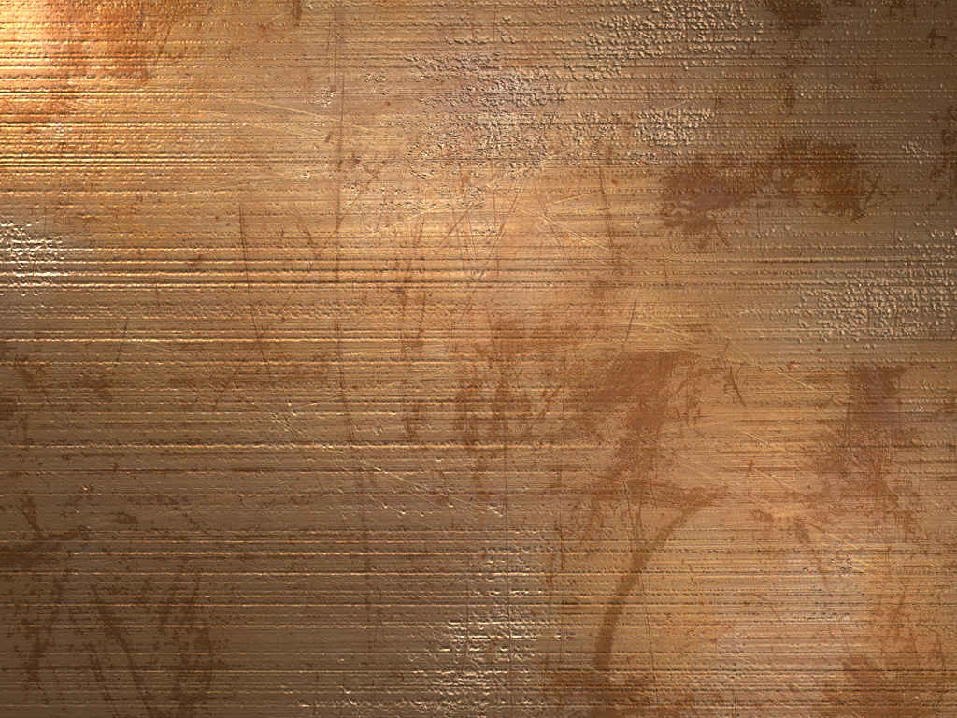
Rapture
Eze. 38-39 War
Abomination of Desolation
Church Age
Tribulation
Millennium
Seals, Trumpets, Bowls
Return of Christ
1 Thessalonians 5:3-28

Slide 22
Books of the Bible referencing the Millennial Kingdom
Genesis
Daniel
Zechariah
2 Samuel
Hosea
Malachi
1 Chronicles
Joel
Matthew
Psalms
Amos
Luke
Isaiah
Micah
Revelation
Jeremiah
Zephaniah
Chap. 20: 6x in 7 vv.
Ezekiel
Haggai
1 Thessalonians 5:3-28

Slide 23

The Millennial Kingdom?
1 Thessalonians 5:3-28

Slide 24
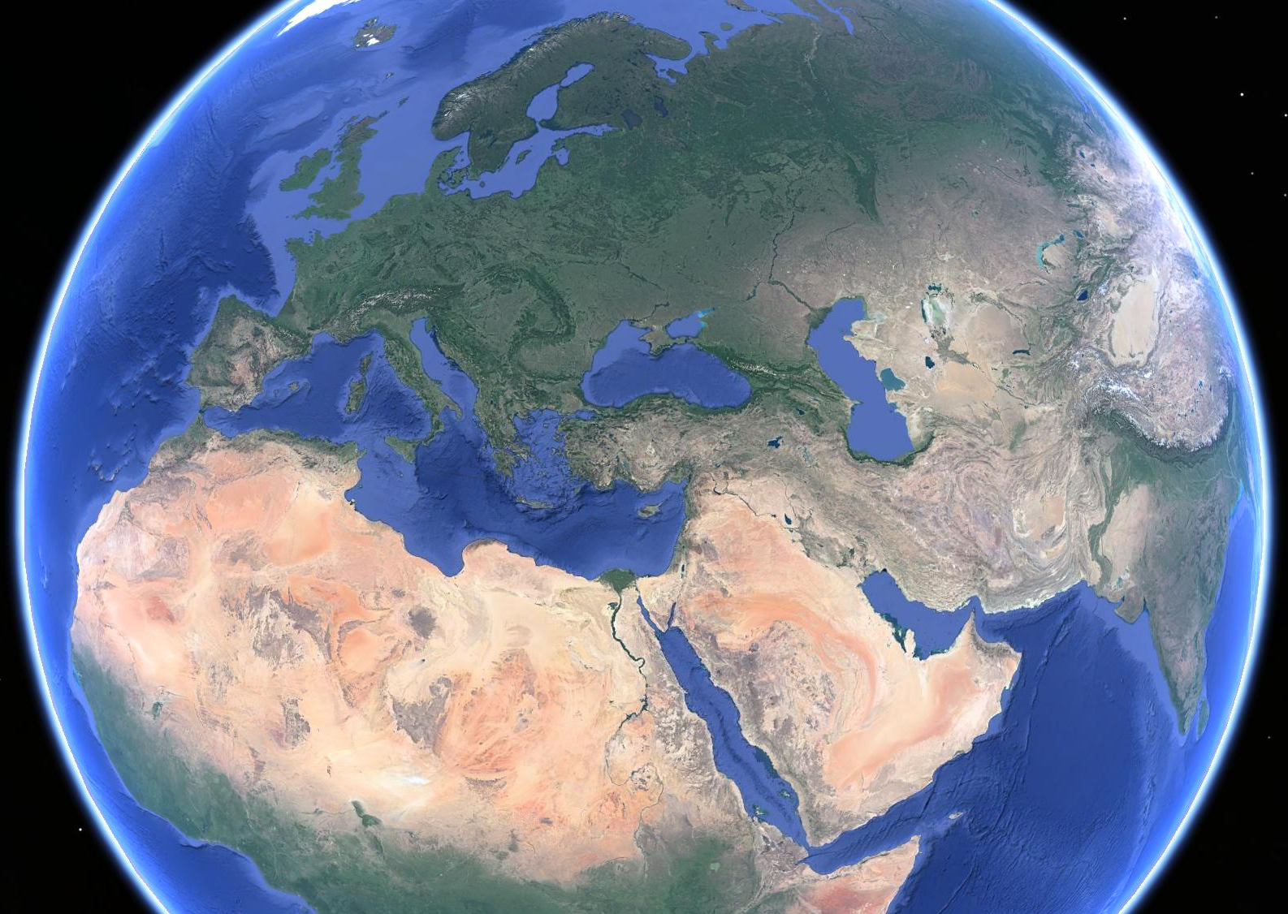
Ezekiel
38-39
Russia
Ukraine
Kazakhstan
Bulgaria
Romania
Georgia
Azerbaijan
Israel
Turkey
Armenia
Syria
Iran
Libya
Saudi Arabia
Sudan
1 Thessalonians 5:3-28

Slide 25
1 Thessalonians 5:3-28

Slide 26
1 Thessalonians 5:3-28

Slide 27
Matt. 24:21-22a ~ ²¹ For then there will be great tribulation, such as has not been since the beginning of the world until this time, no, nor ever shall be.
^{22a} And unless those days were shortened, no flesh would be saved;
1 Thessalonians 5:3-28

Slide 28
1 Thessalonians 5:3-28

Slide 29
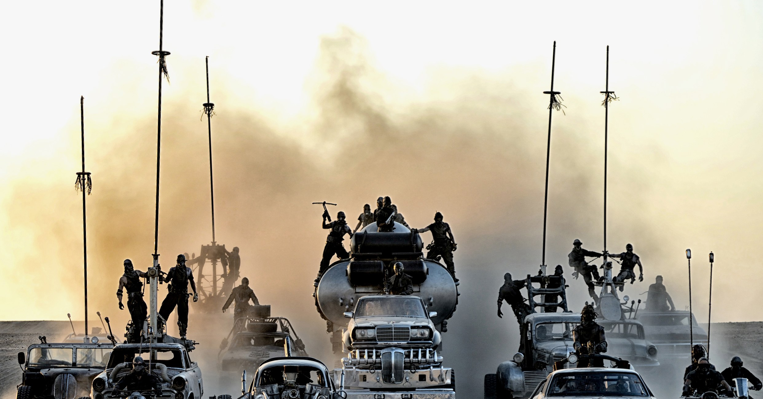
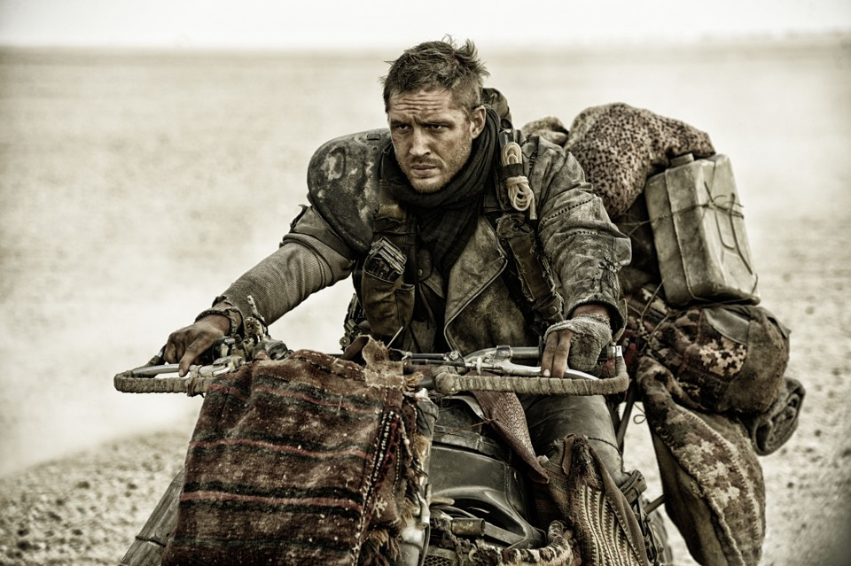
1 Thessalonians 5:3-28

Slide 30
1 Thessalonians 5:3-28

Slide 31
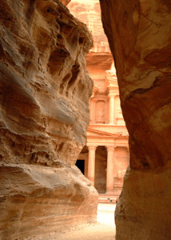
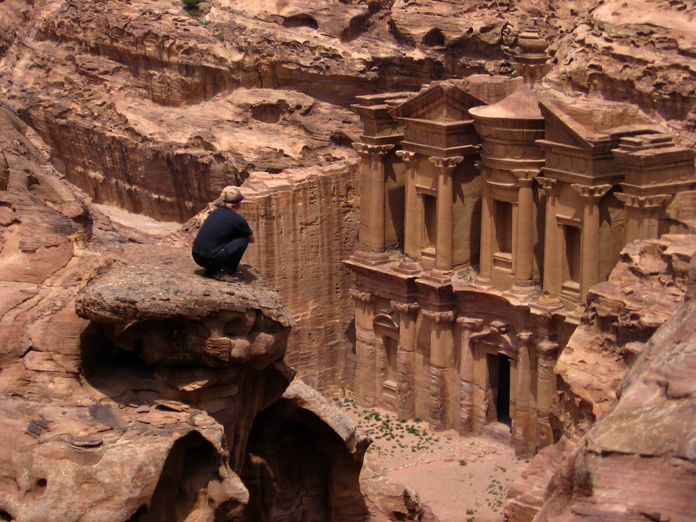
1 Thessalonians 5:3-28

Slide 32
1 Thessalonians 5:3-28

Slide 33
Edify ~ oikodomeō – literally, house builder
1 Thessalonians 5:3-28

Slide 34
1 Thessalonians 5:3-28

Slide 35
unruly ~ ataktos – out of place
fainthearted ~ oligopsuchos – literally, small souled
oligos ~ few, little (oligarchy)
psuchē ~ soul (psychology)
1 Thessalonians 5:3-28

Slide 36
1 Thessalonians 5:3-28

Slide 37
J. B. Lightfoot ~ “It is not in the moving of the lips, but in the elevation of the heart to God, that the essence of prayer consists.”
1 Thessalonians 5:3-28

Slide 38
1 Thessalonians 5:3-28

